Slide 1
Mapping Tongan farms with QField

Slide 2
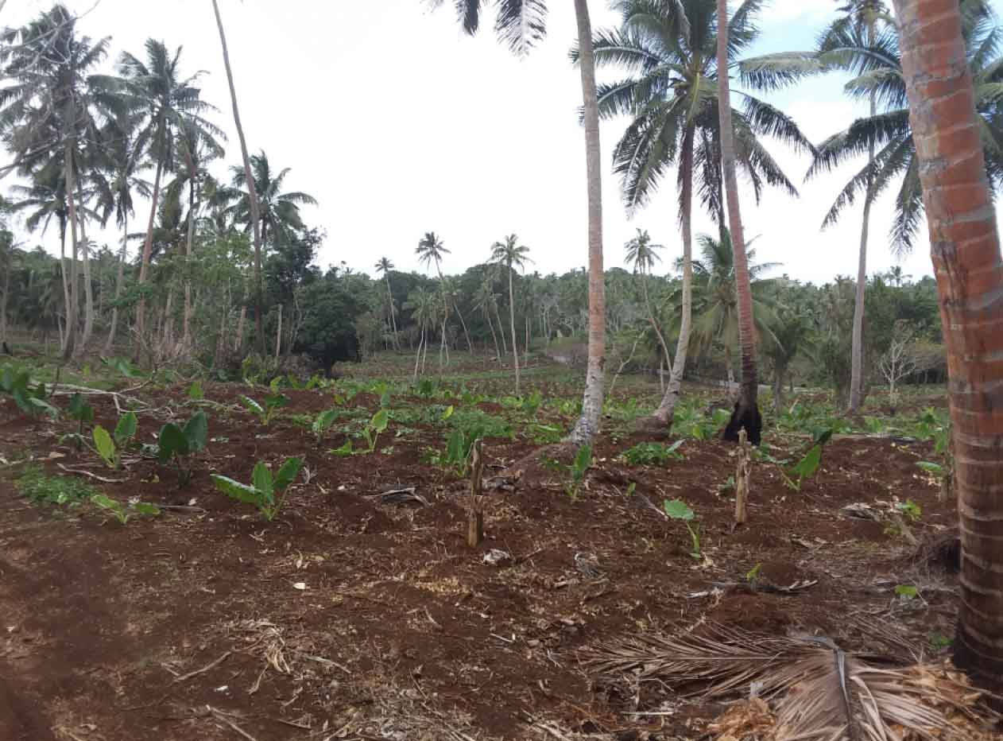
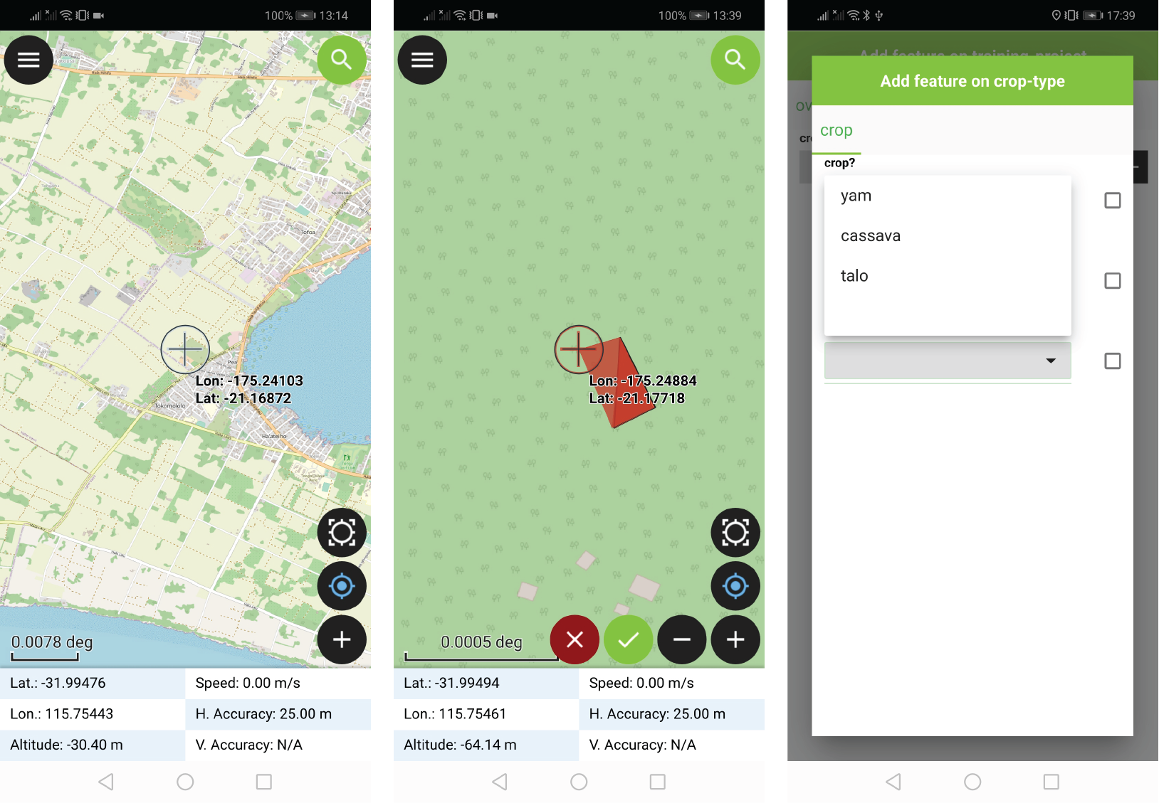
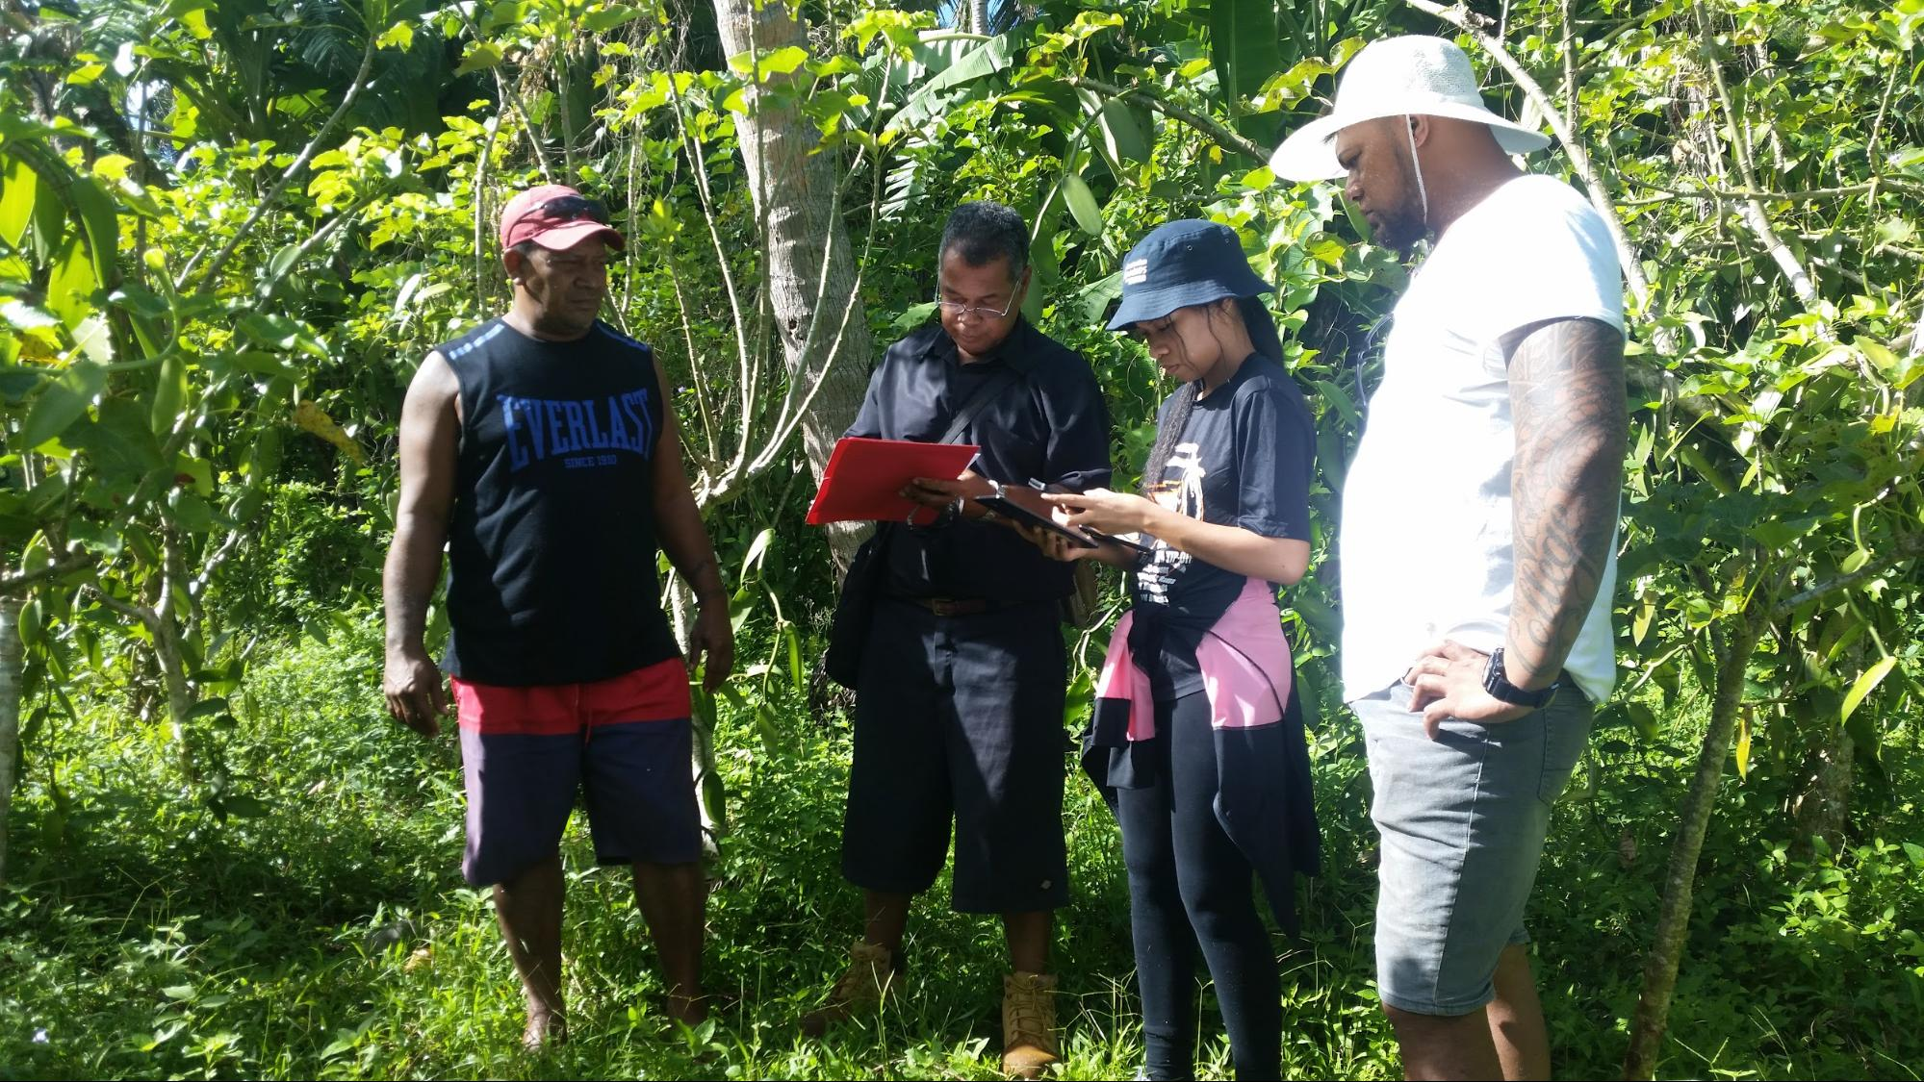
Overview
A workflow to map farms and record information about farm management and condition using open-source software.

Slide 3
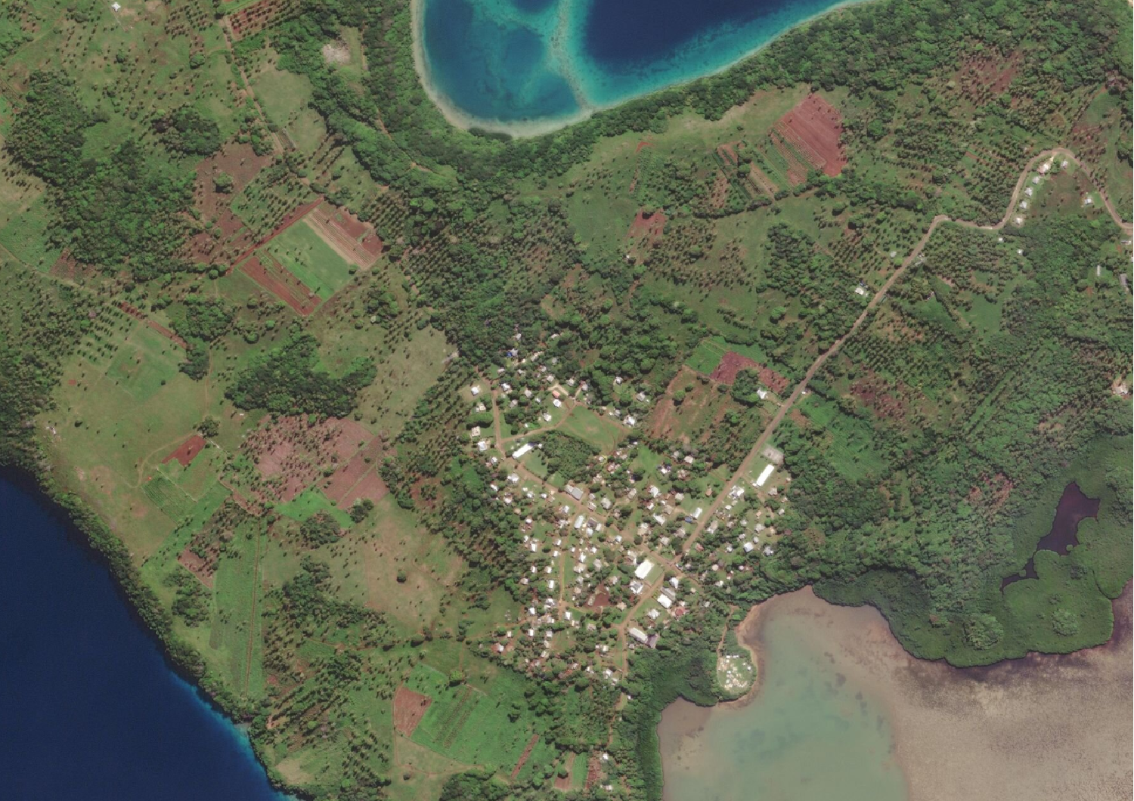
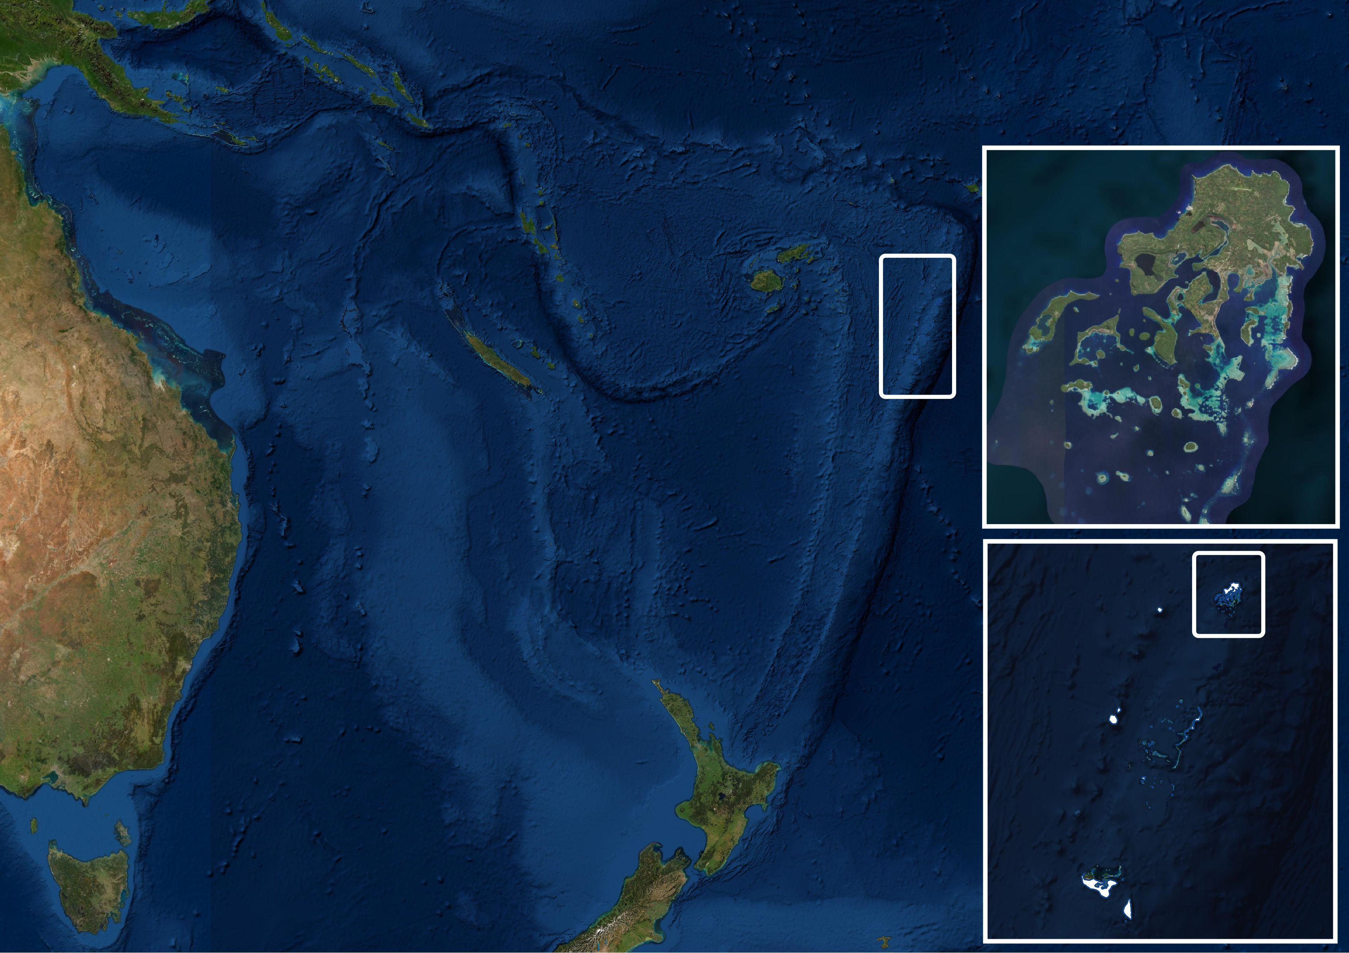
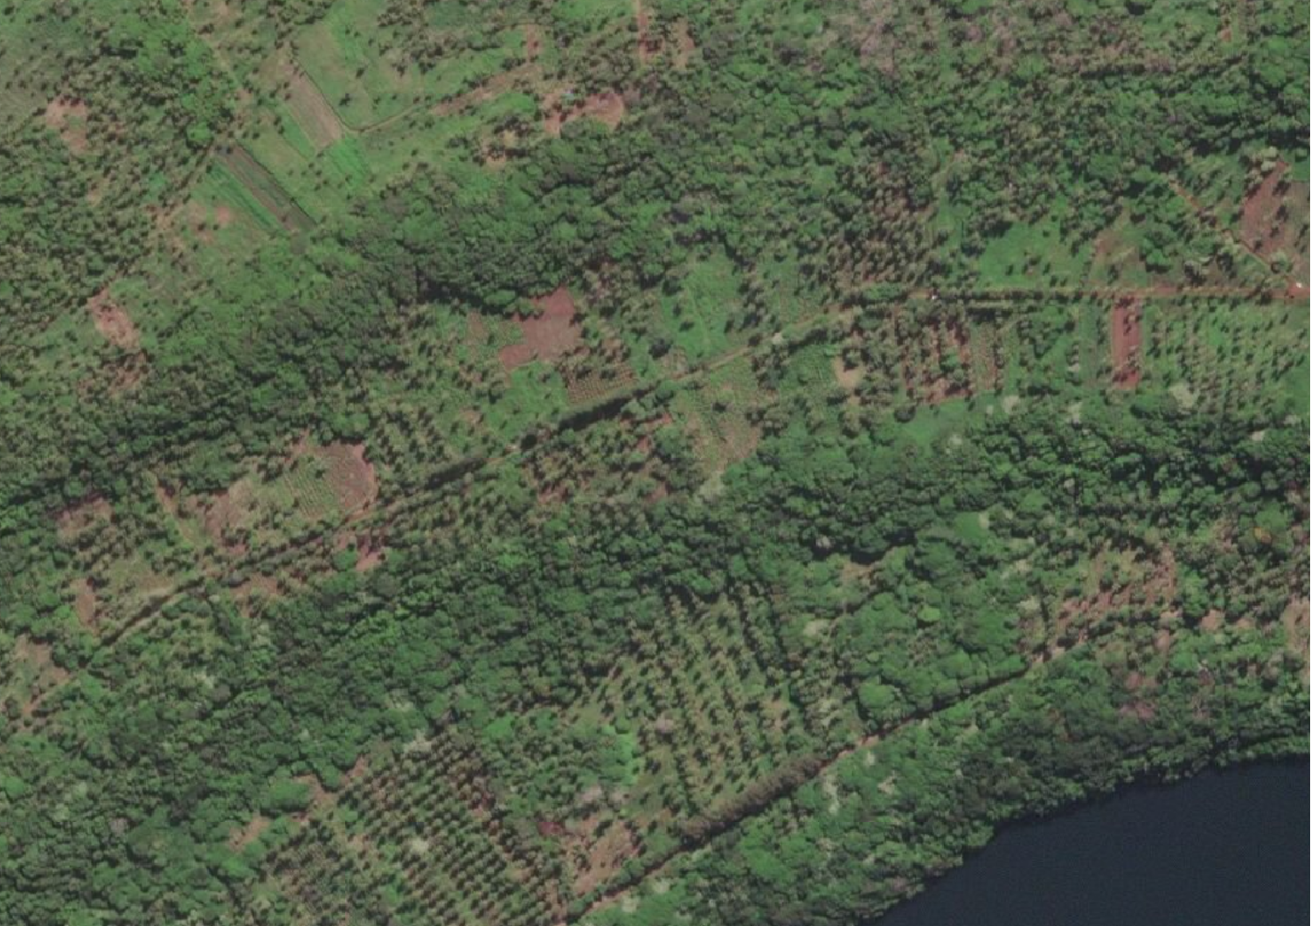
Tonga

Slide 4
Farm mapping and crop surveys
Map farm extents
Map features within farms (e.g. crop parcels, intercropping, fruit trees)
Collect attributes about farm management and condition
Browse geospatial data layers in the field
Easy to use for non-GIS experts

Slide 5
Workflow – Tonga Crop Survey
QField: mobile data collection
QGIS: project creation
Shiny dashboard:
Sync, visualise, and analyse data
Google Cloud Storage: secure data storage
Express.js server app to handle uploads and downloads

Slide 6
QField: field data collection
Review of over 100 mobile GIS apps
Field testing in Fiji and Tonga
Syncing with spatial databases
View secondary geospatial data layers

Slide 7
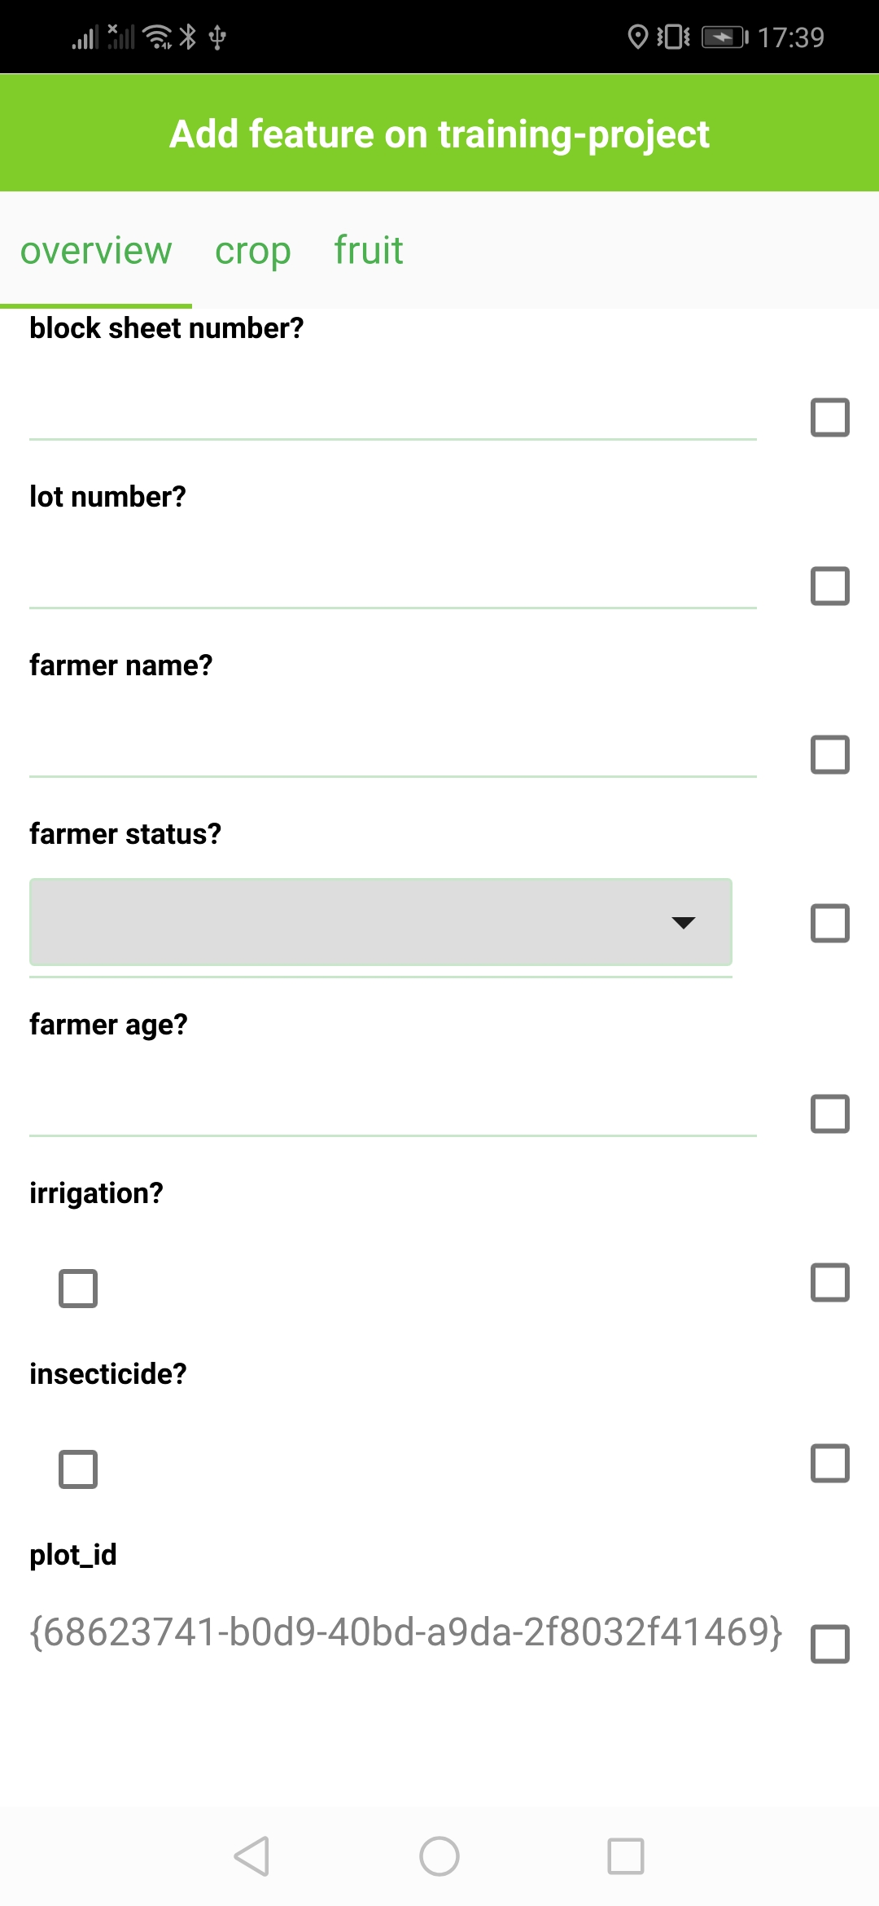
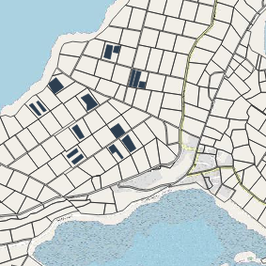
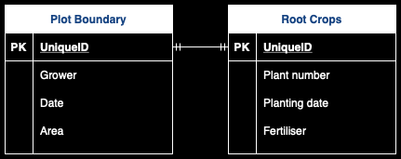
QField: key features
Spatial database
Map interface
Digital forms
spatial and non-spatial tables
relational data structure to drive survey logic
Touch optimised map interface:
digitise landscape features
browse reference geospatial layers
Form widgets to capture attribute information (text entry, checkbox, slider, dropdown lists, photos …)

Slide 8
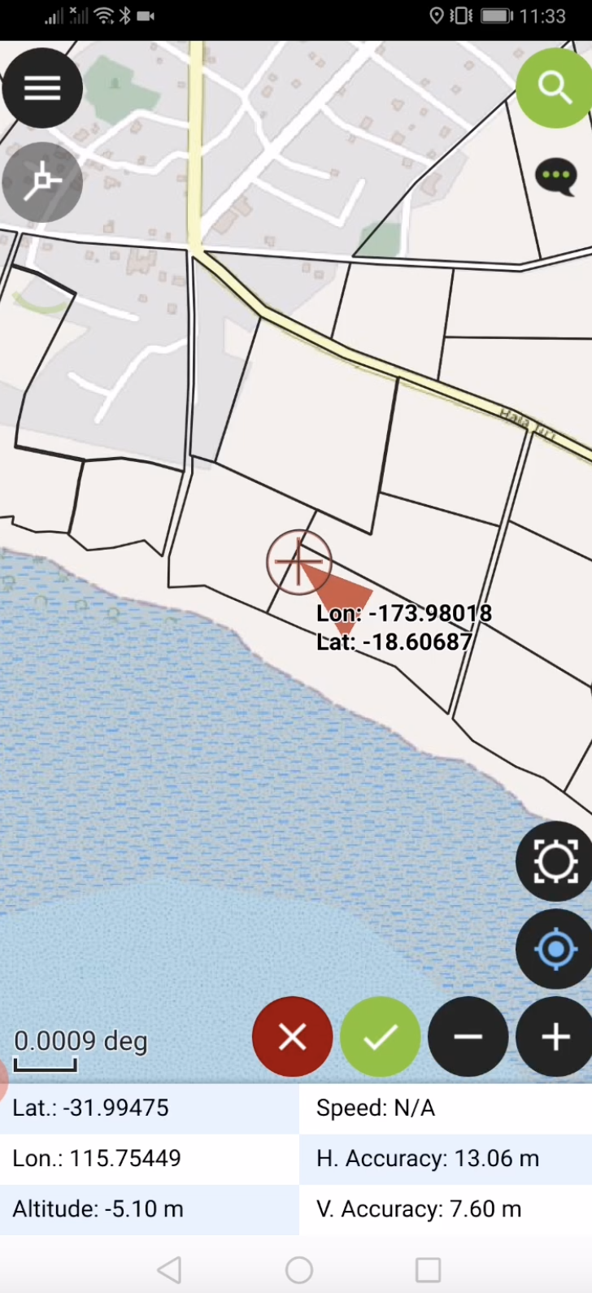
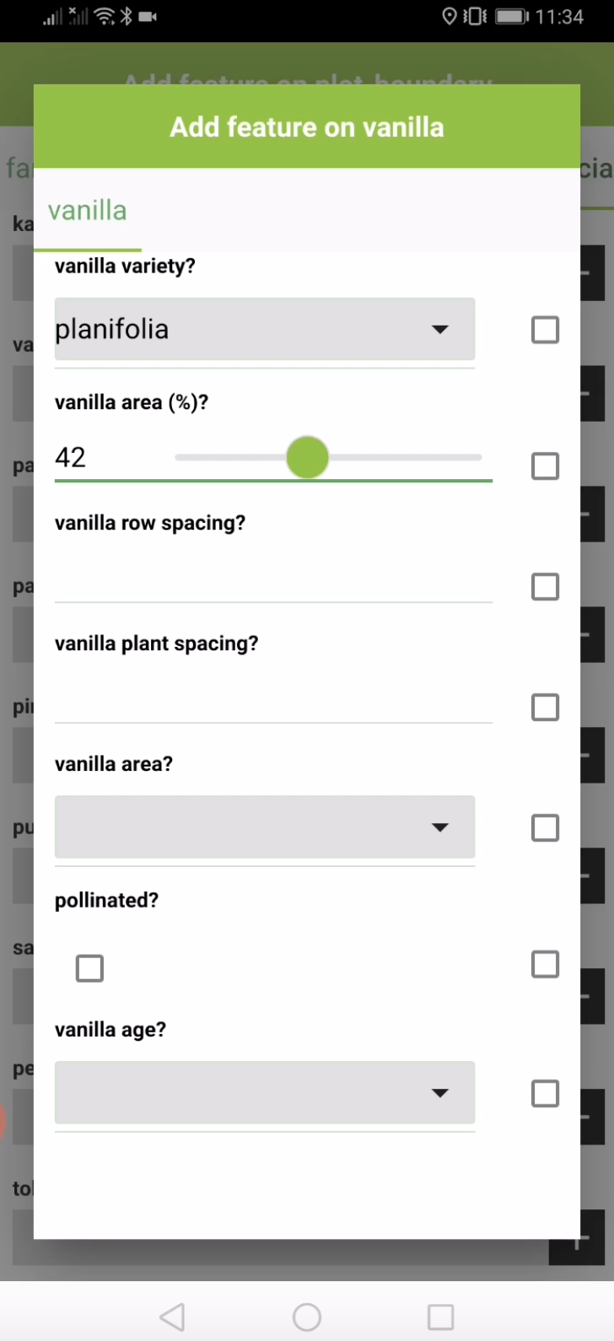
QField: Tonga crop survey
QField: collect attribute information using digital forms
QField: digitise spatial features (fields)

Slide 9
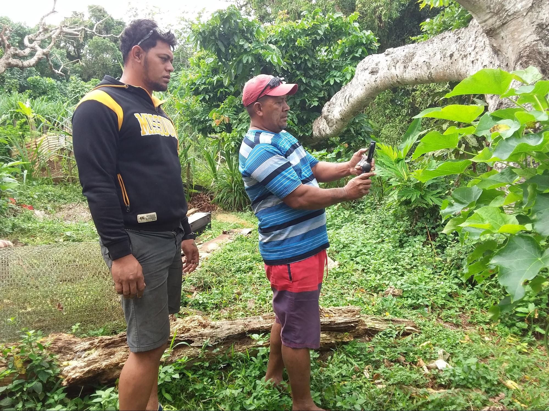
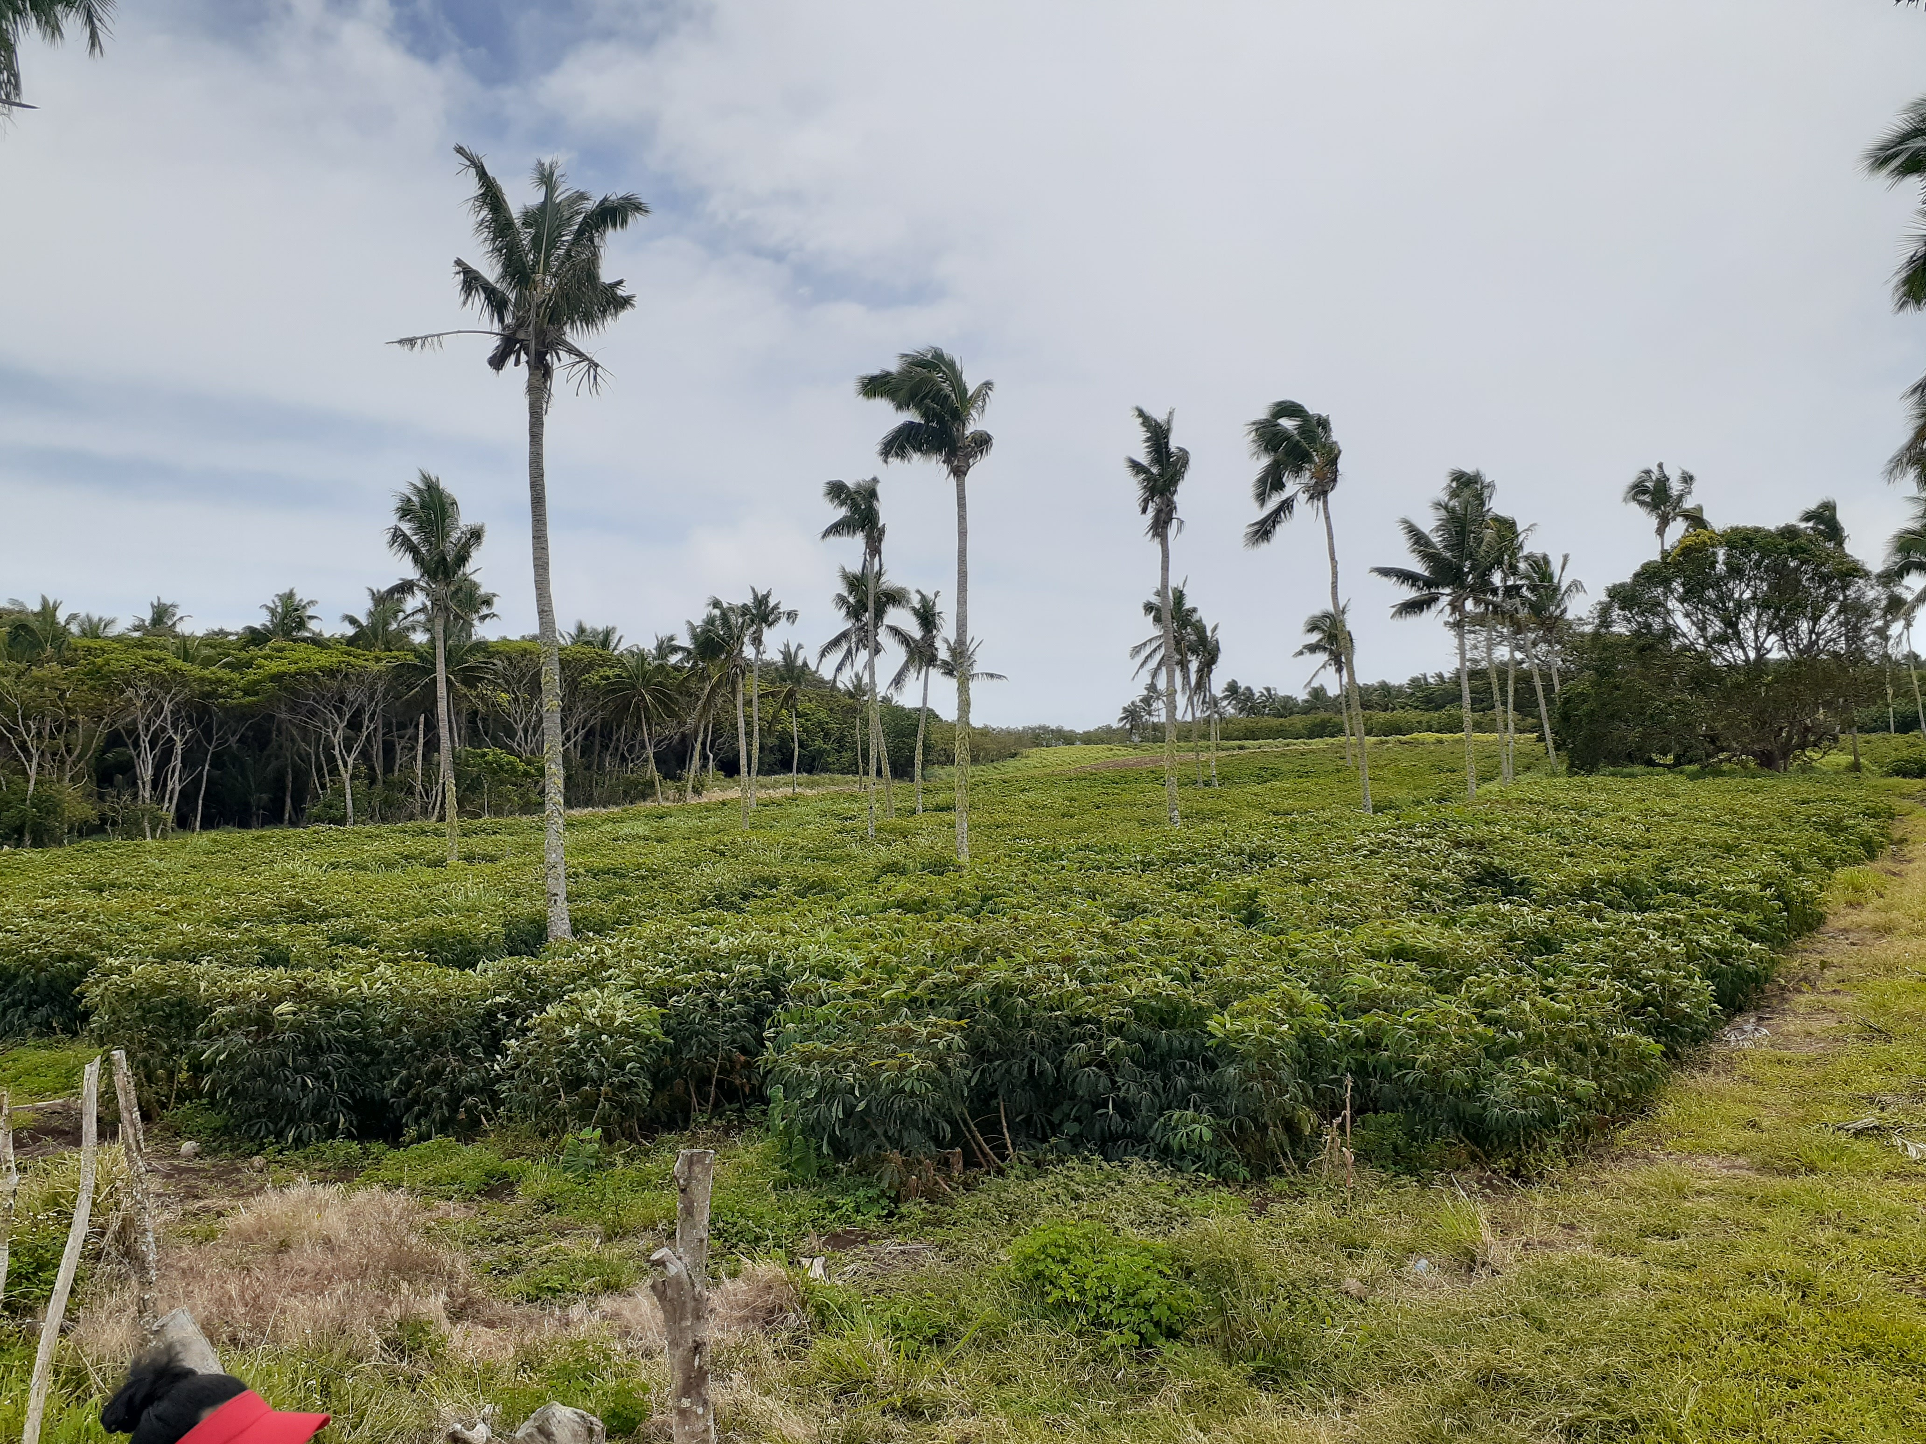
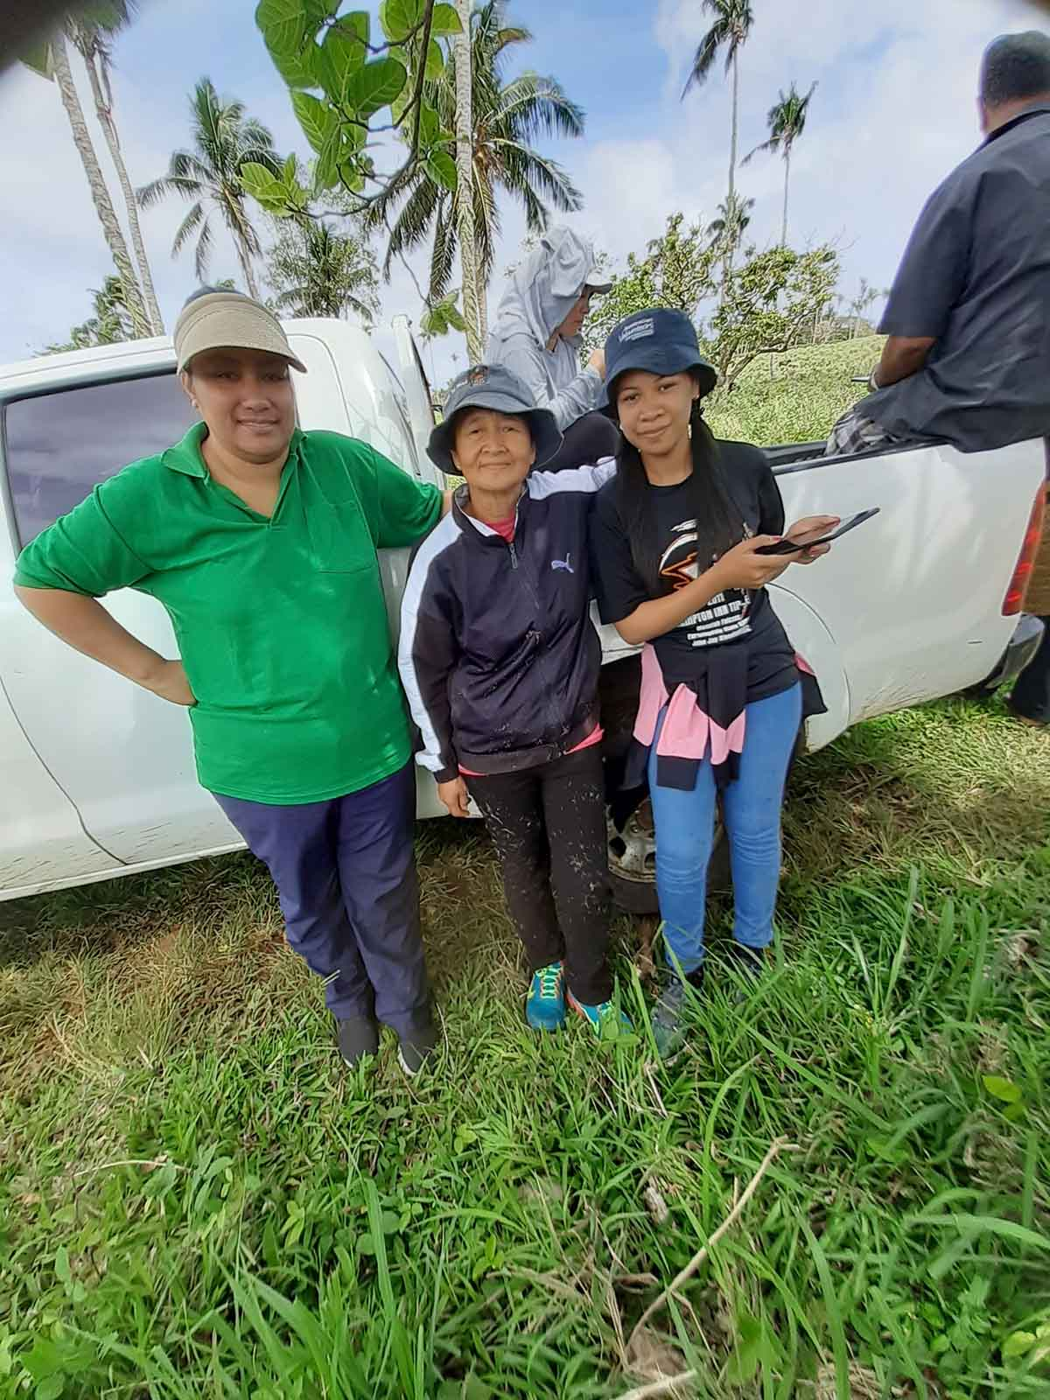
QField: farm mapping applications
Vanilla plantations
Land utilisation
Tonga crop survey
Mapping vanilla plantations to identify plots under poor management conditions
Mapping grower group’s utilisation of farm land to allocate fuel and resources to bring more land under cultivation
Mapping intra-farm crop cover and management practices to inform landscape management

Slide 10
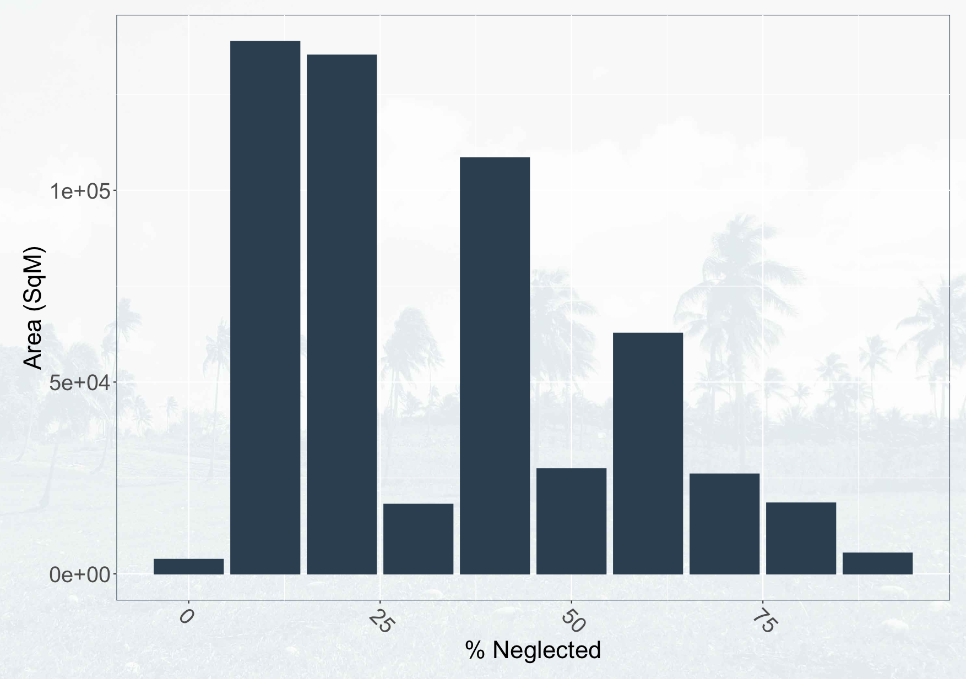
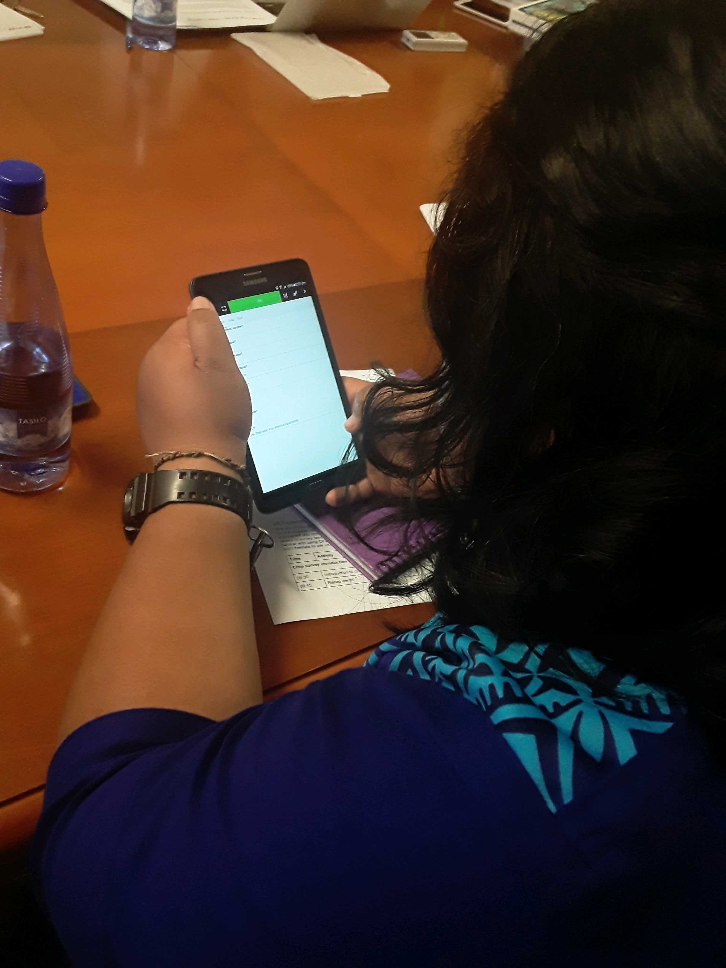
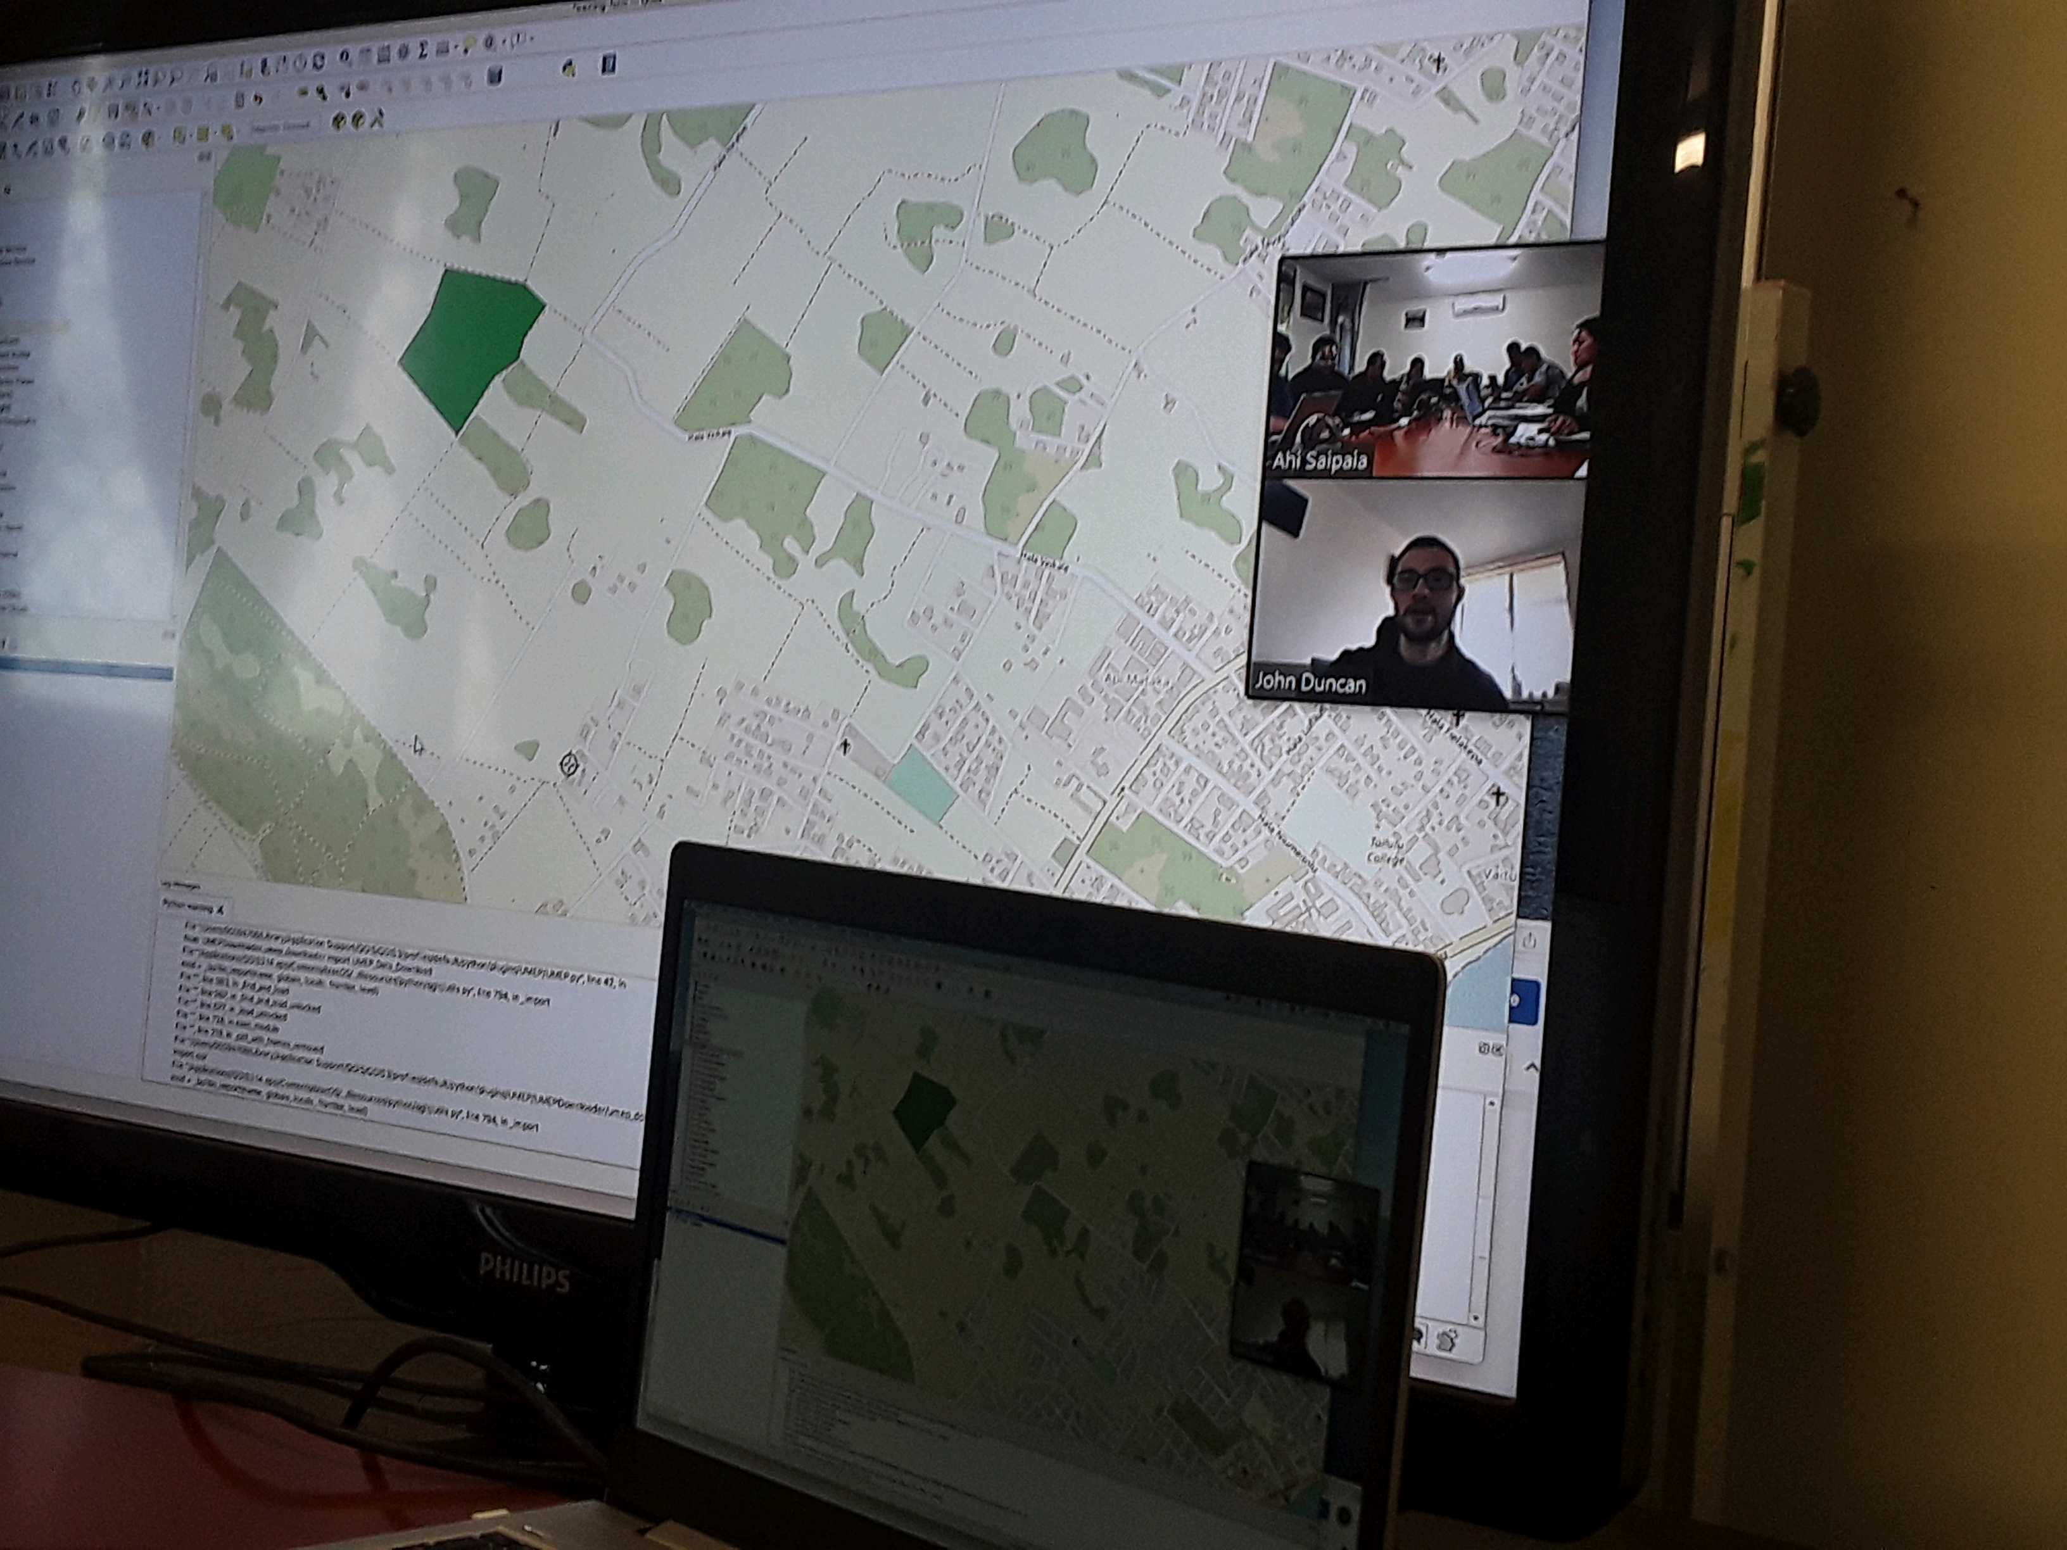
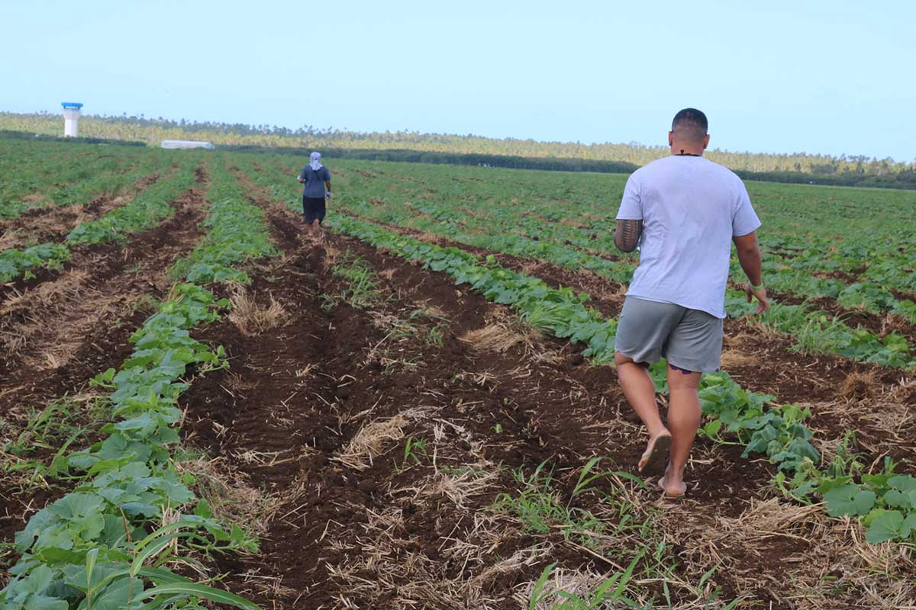
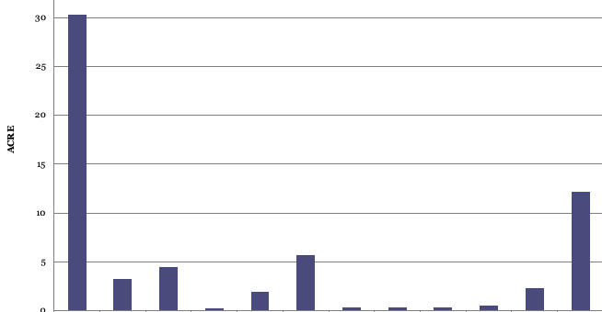
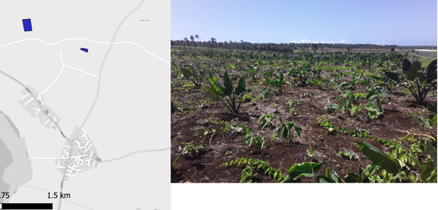
QField: farm mapping applications
Identifying neglected vanilla plantations
Classroom and in-the-field training on QField for crop survey data collection
Communicating land utilisation data to government officials, community leaders, and grower groups

Slide 11
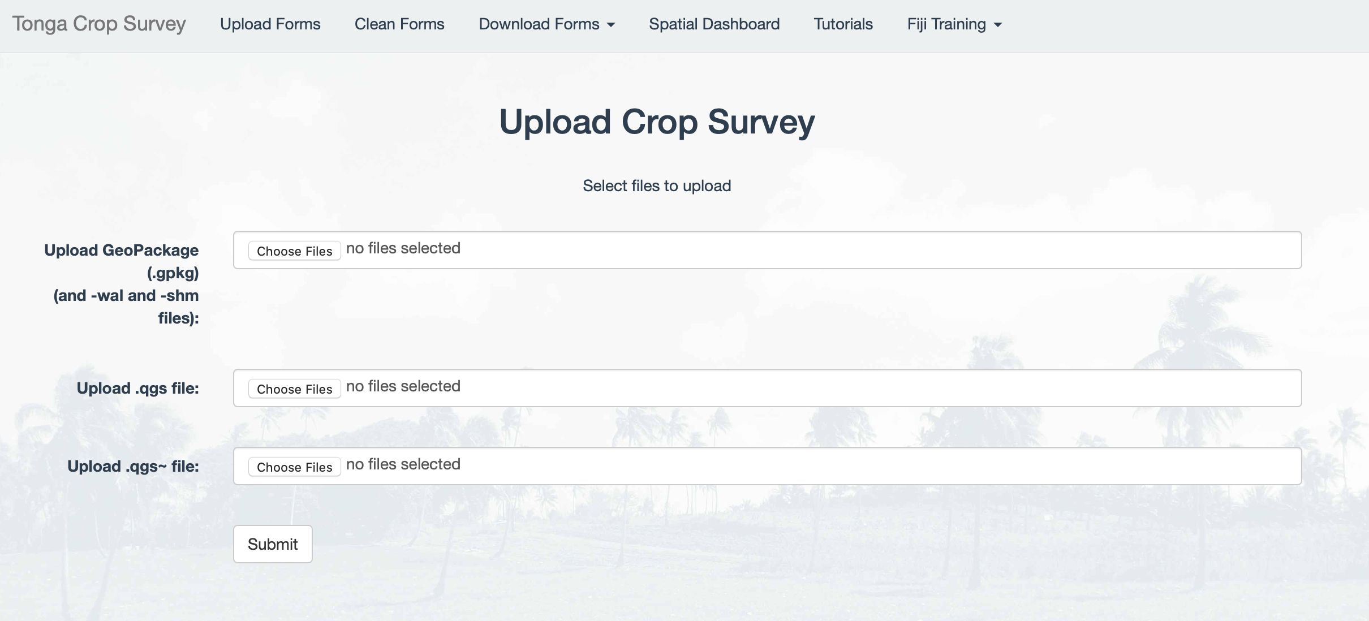
Data management
Web form to upload data collected in the field
Express.js server-side app to handle data uploads and downloads
Store data in Google Cloud Storage bucket (PostgreSQL an option)

Slide 12
Data visualisation, analysis, and reporting
map.landscape Shiny dashboard
Sync forms from multiple mobile devices
Join spatial layers and non-spatial tables
Compute summary tables
“Create your own” web maps and charts
Interactive tables

Slide 13
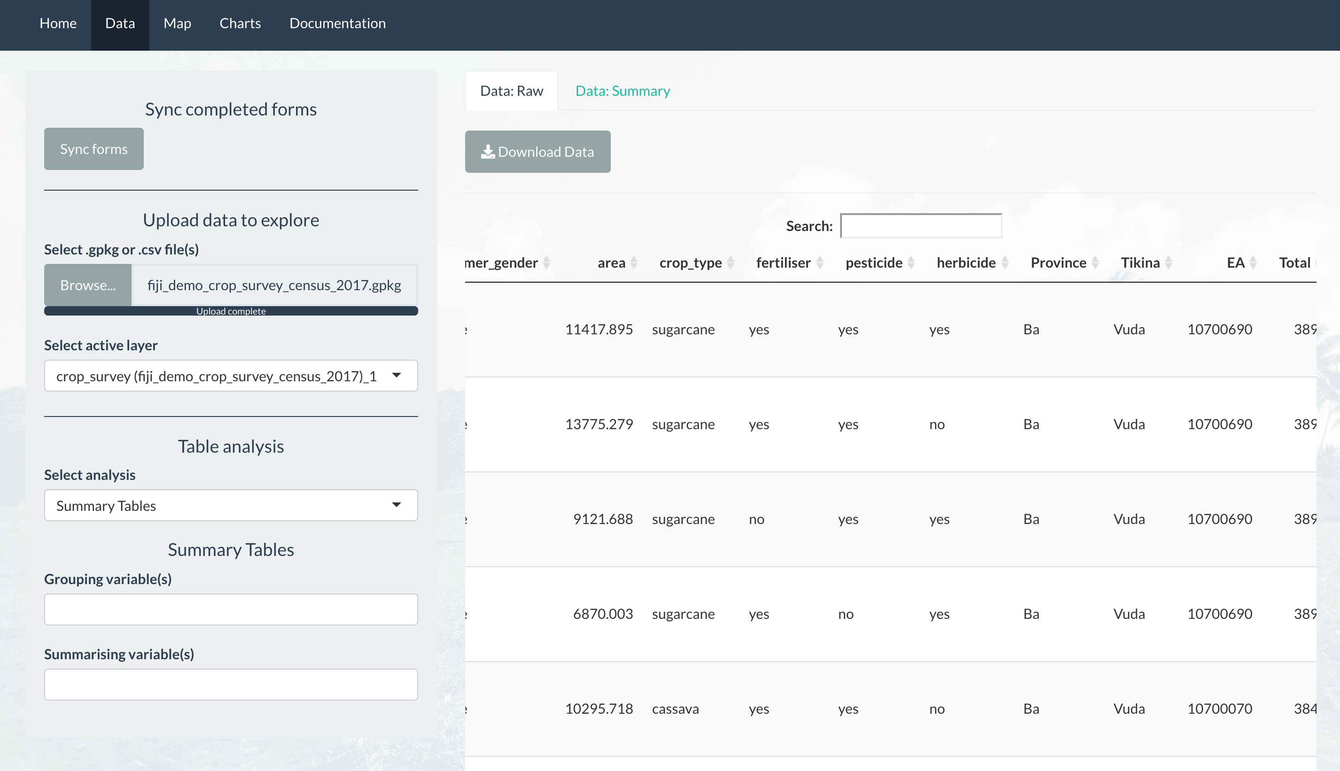
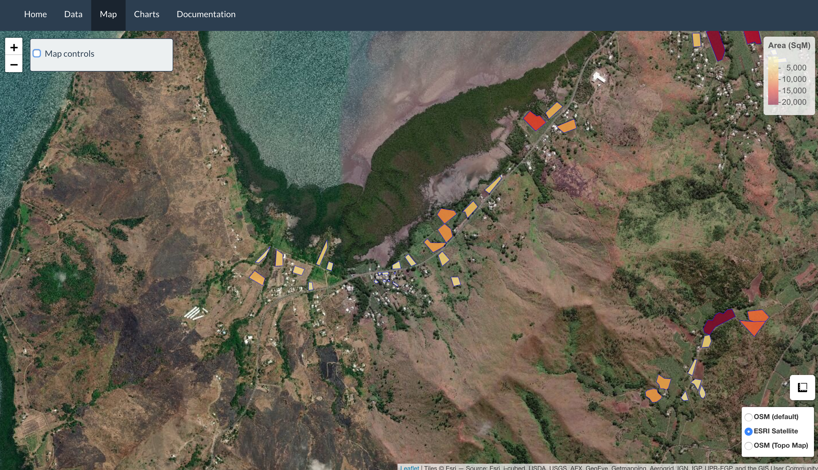
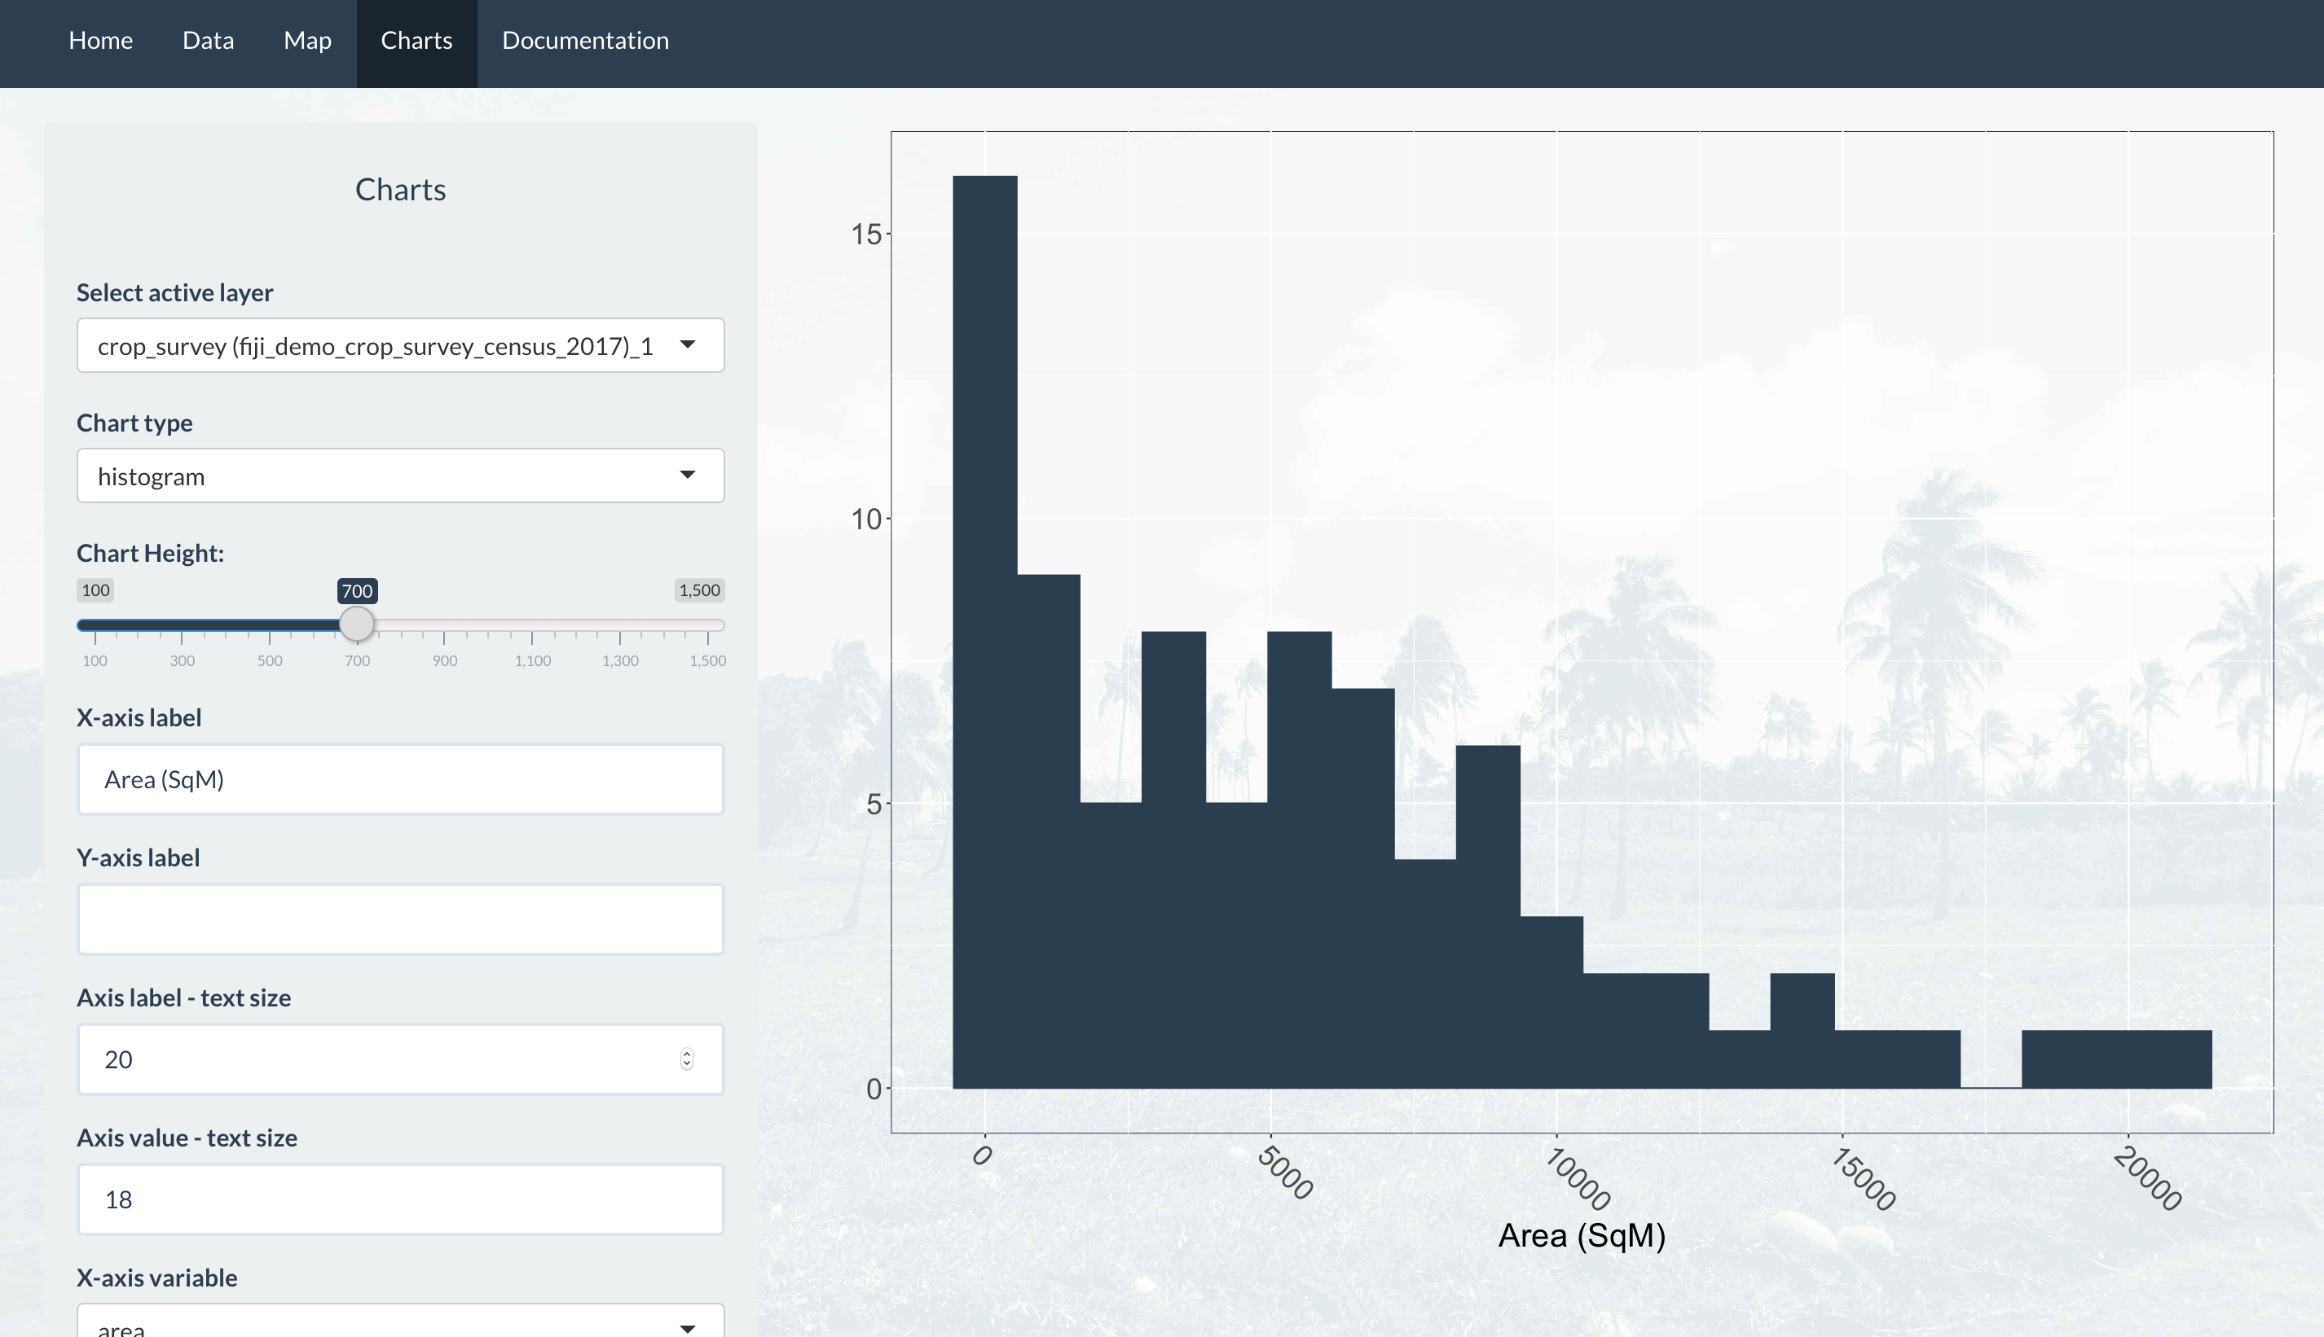
map.landscape Shiny dashboard
Interactive tables
Web maps
Charts
Explore data using interactive DataTables.
Table operations: data syncing, group-by and summarise, spatial and non-spatial joins.
Visualise and style features on Leaflet web maps.
Create charts to see patterns and trends in data collected in the field.

Slide 14
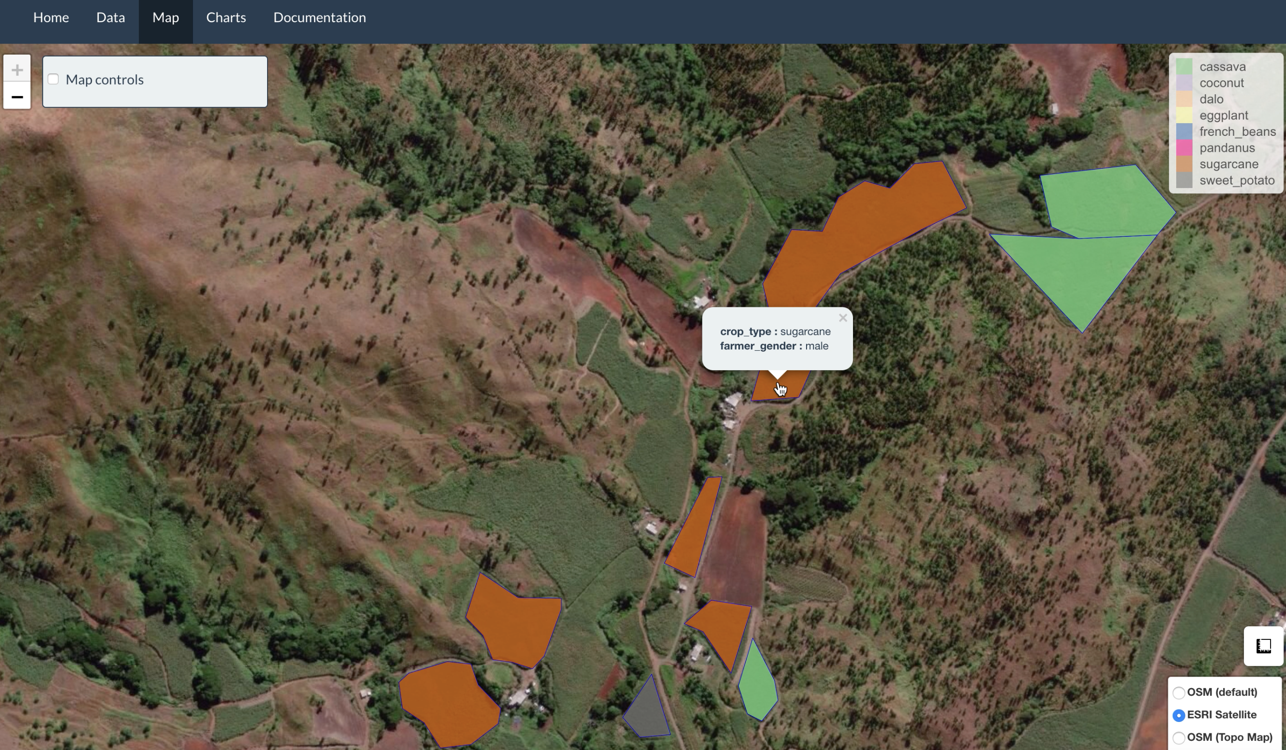
map.landscape Shiny dashboard

Slide 15
Moving Forward
Tonga crop survey is on-going across four island groups (Vava’u, Tongatapu, Eua, and Ha’apai)
Use data for sustainable landscape and agricultural management
Refine workflow and software using feedback from the Tonga crop survey activities
Capacity building and training
Collaboration with Fiji’s Ministry of Agriculture

Slide 16
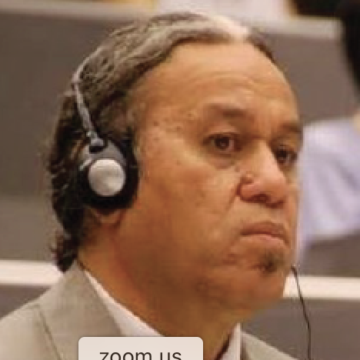
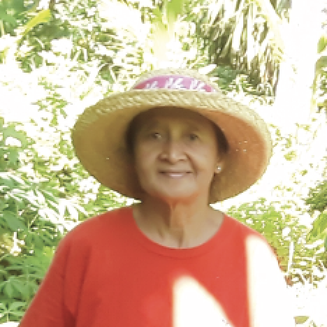
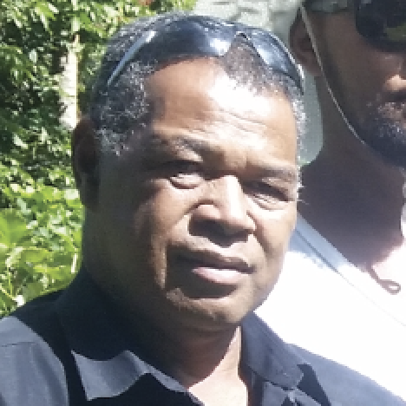
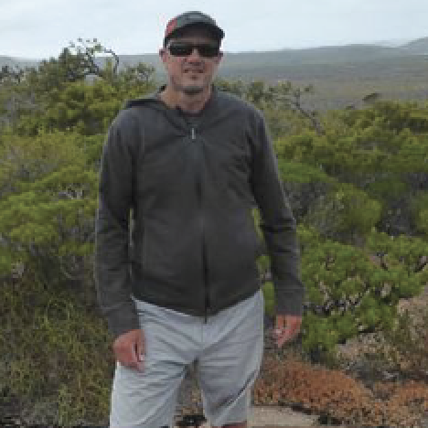
Thanks to the team!

